Slide 1


IoT Based Electricity Energy Meter using ESP32 & Blynk
Presented by
3rd B. Tech ECE-A Section, Batch No: A1
1. B. Naga Mani 19481A0417
2. Abdul Sattar 20485A0401
3. Ch. Jaimini Sowmya 19481A0444
4. G.Ravi Kiran 19481A0460
Guided by- Dr. Ch. Balaswamy
Department of ECE

Slide 2
Objective of the Project :
The main objective of this project is with the current technology, you need to go to the meter reading room and take down readings.
As a result, keeping track of your electricity consumption is a time consuming chore. We can use the Internet of Things to automate this.
So using IOT we can examine the readings without manual involvement.

Slide 3
ABSTRACT:
In this project, we will learn how to make our own IoT Based Electricity Energy Meter using ESP 32 and monitor data on the Blynk Application. With the current technology, you need to go to the meter reading room and take down readings.
Thus monitoring and keeping track records of electricity consumption is a tedious task. To automate this, we can use the Internet of Things. The Internet of Things saves time and money by automating remote data collection.

Slide 4
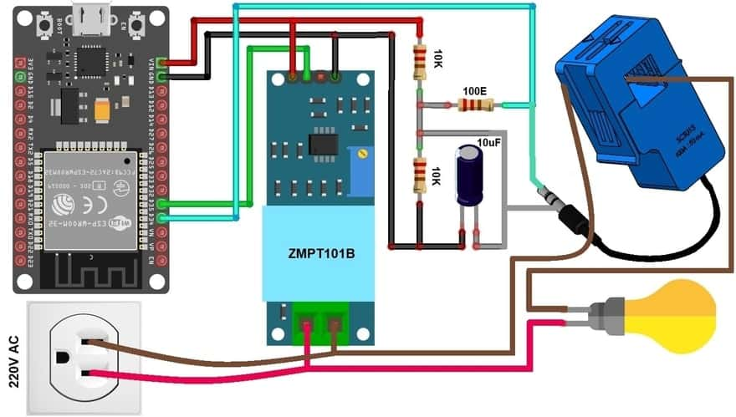
BLOCK DIAGRAM :

Slide 5
Hardware Equipment :
SL.NO | COMPONENTS | DESCRIPTION
1 | ESP32 Board | ESP32 Development Board (ESP-WROOM-32)
2 | Voltage Sensor | ZMPT101B AC Voltage Sensor Module
3 | Current Sensor | SCT-013-030 Non-invasive AC Current Sensor
4 | LCD Display | 16X2 I2C LCD Display
5 | Resistor | 10K , 100 ohm
6 | Capacitor | 10uF
7 | Connecting Wires | Jumper Wires

Slide 6
SOFTWARE TOOLS:
Arduino IDE
It is an open source Arduino software that allows you to build and test instructions that compose a program or a sketch for Arduino boards. It facilitates the writing of code. It's simple to use and allows you to upload sketches to the microcontroller boards
Blynk Application :
Blynk an application that runs Android and IOS devices to control any IoT based application using Smartphones. It allows you to create your Graphical user interface for IoT application. Here we will display the IoT Energy Meter Data on Blynk Application.

Slide 7
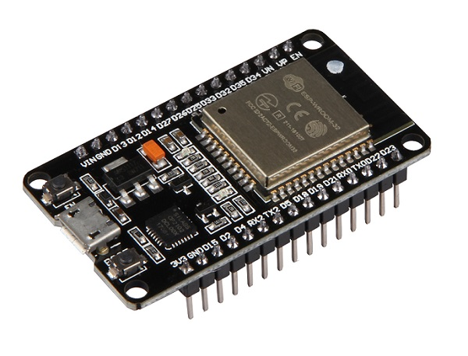
ESP32 Board
ESP32 is a series of low-cost, low-power system on a chip microcontrollers with integrated Wi-Fi and dual-mode Bluetooth
Specifications ESP32 Microcontroller :
Operating Voltage - 2.2 to 3.6 V
GPIO - 36 ports
ADC - 14 ports
DAC - 2 ports
Flash Memory - 16 Mbyte
SRAM - 250 Kbyte
Clock Speed - Up to 240 MHz
WI-FI - 2.4 GHz

Slide 8
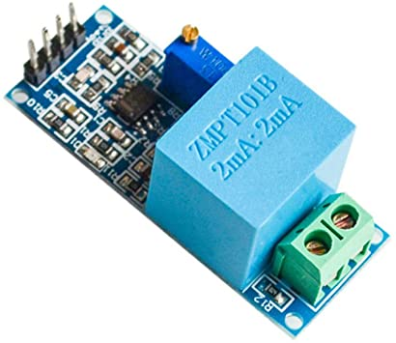
ZMPT101B AC Single Phase Voltage Sensor
The ZMPT101B AC Single Phase voltage sensor module is based on a high precision ZMPT101B voltage Transformer used to measure the accurate AC voltage with a voltage transformer.
This is an ideal choice to measure the AC voltage using Arduino or ESP32.

Slide 9
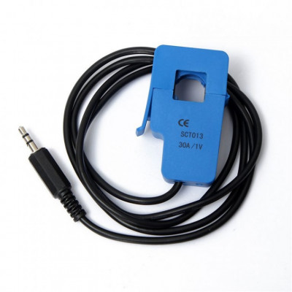
SCT-013 Current Sensor
The SCT-013 is a Non-invasive AC Current Sensor Split Core Type Clamp Meter Sensor that can be used to measure AC current up to 100 amperes.
Current transformers (CTs) are sensors are for measuring alternating current. They are particularly useful for measuring whole building electricity consumption.
The SCT-013 current sensors can be clipped straight either to the live or neutral wire without having to do any high voltage electrical work.

Slide 10
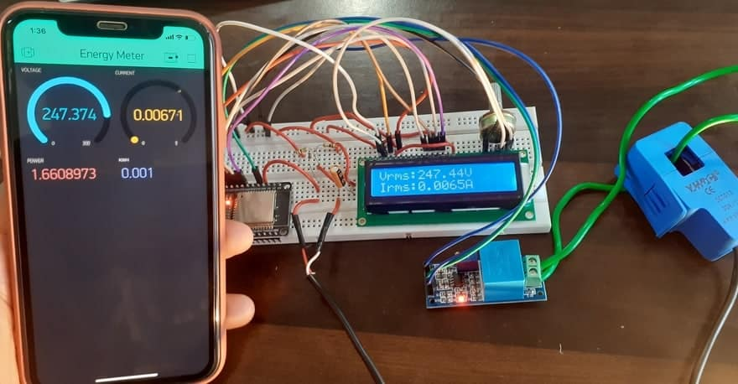
Implemented Prototype with Blynk App on smartphone

Slide 11
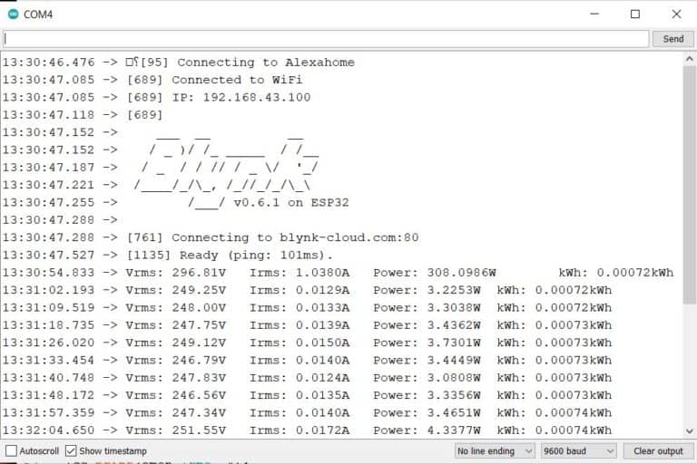
Serial Monitor Results
The sensor data comprising of Vrms Irms, Power and Energy consumption can be observed on Serial Monitor COM port 4 as from the ESP32 electric energy consumption meter using the baud rate of 9600.

Slide 12
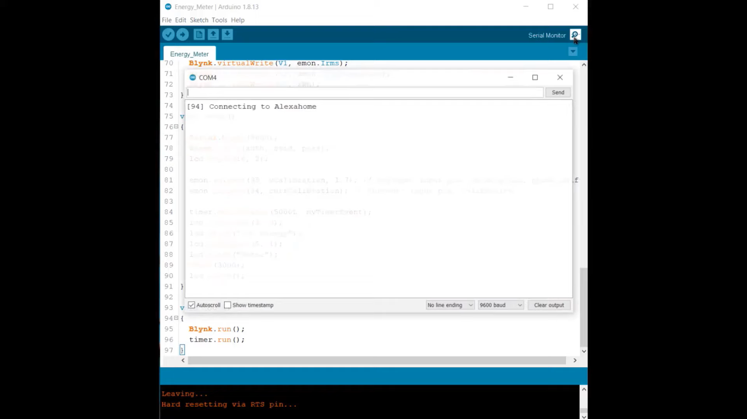
Results

Slide 13
Conclusion
The proposed Smart Metering System is capable of monitoring various parameters of electrical energy like Voltage, Power Factor, Current, energy consumption in kWh etc., and the consumer can take suitable precautions to safe guard the electrical appliances.
This makes the consumer an active part of Energy Management. The consumer can also monitor the load during peak hours.

Slide 14
REFERENCES:
K. Li, J. Liu, C. Yue and M. Zhang, "Remote power management and meter-reading system based on ARM microprocessor", IEEE Precision Electromagnetic Measurements Digest CPEM, pp. 216-217, June, 2008
[2] ESP8266 802.11bgn Smart Device/Expressifsystems/October 2013
https://how2electronics.com/iot-based-electricity-energy-meter-using-esp32-blynk/

Slide 15


